Slide 1
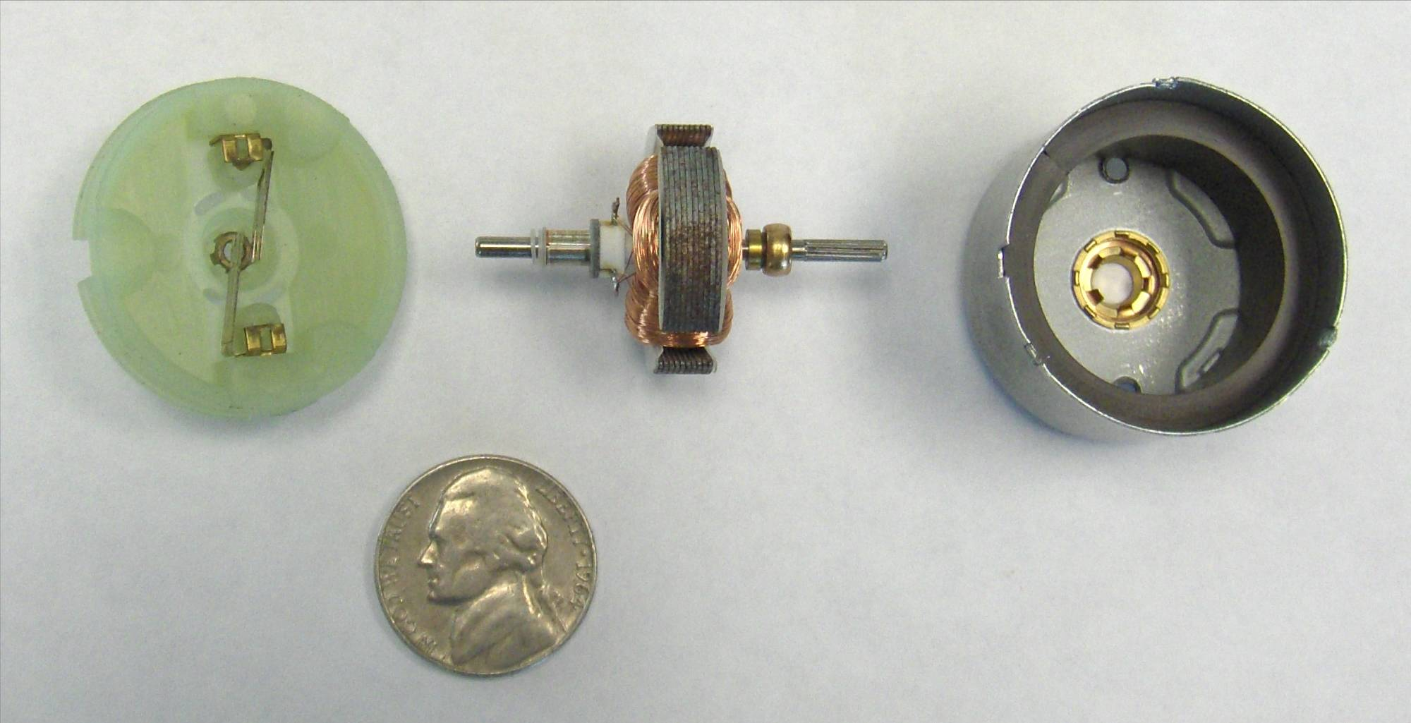
Permanent magnet (PM) DC motors
Armature
Commutator
Coils
Brushes
Permanent Magnets
1

Slide 2
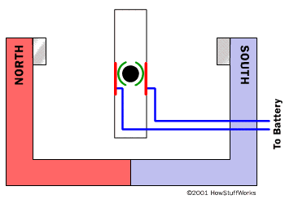

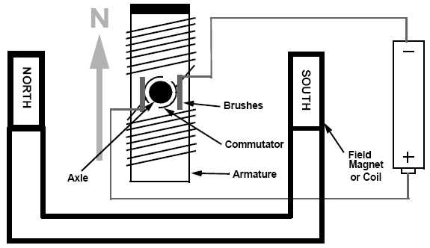
PMDC motors – animation

Slide 3
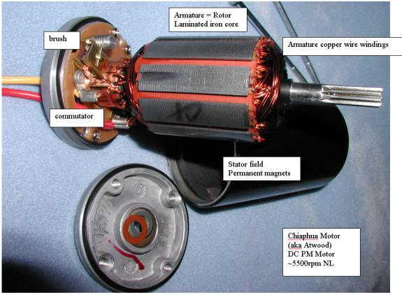
PMDC motors – components
3
Notes:
3

Slide 4
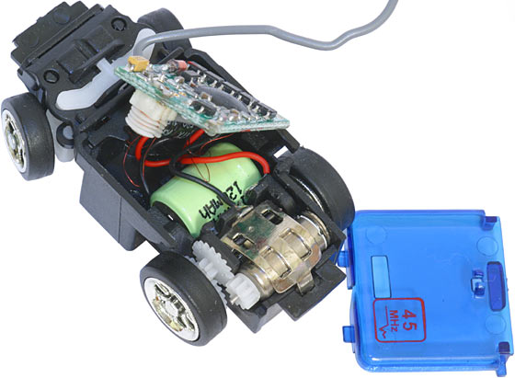
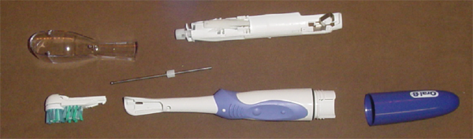

PMDC motors
Stationary element is a permanent magnet
Have commutator and brushes to switch current direction in armature
Limited in size (large magnets are expensive)
Low cost, low power, battery operation
Common in appliances, toys, RC
Electric Toothbrush

Slide 5
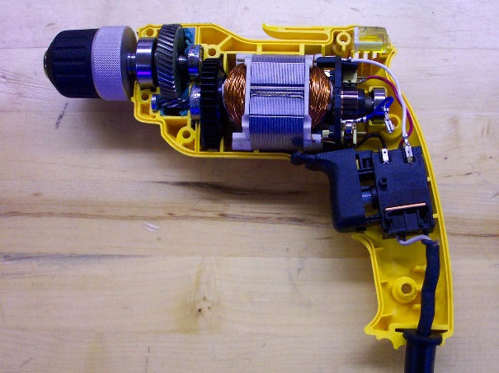
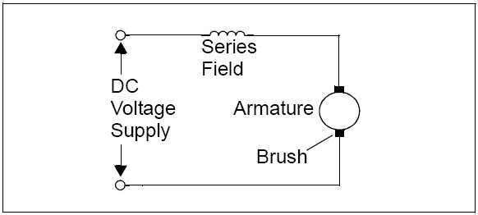
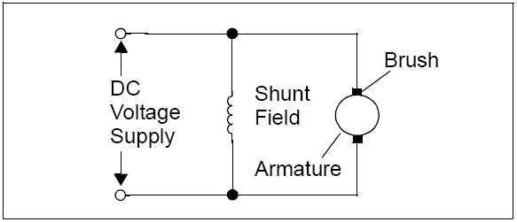
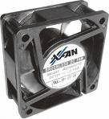
Other types of DC motors
Wound Stator
  Stationary element is an electromagnet
  Connected in series or parallel with armature
  Commutator and brushes
  Can run on DC or AC current (universal motor)
Brushless
  No brushes to wear out or cause electrical noise
  More complicated to control
  Used in computer disc drives, fans
series wound
shunt wound

Slide 6
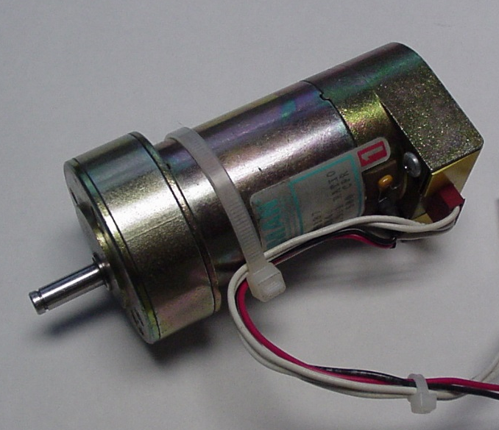
PMDC motors
Typical Uses: Small appliances, RC, often battery powered
Often used with position or velocity feedback (optical encoder or tachometer)
Reduction gear heads common
Easy to control:
  Speed, Torque ∝ Input voltage
Size Range:
  Micro 0.5” L x 0.2”D (pager vibrator) <$1
  Big 13”L x 4”D 2 HP $1000
Torque
V₂ >V₁
V₁
RPM

Slide 7
Basic principle of operation – a wire in a magnetic field will be feel a sidewise force
Conductor in a magnetic field: (Fleming’s Rule)
Force = I L B
Permanent
Magnet
N
B = magnetic flux density
F = force
L = length of wire
in the magnetic field
S
I = current

Slide 8
In a motor, we have coils of wires, so the force becomes a moment
For each turn of the coil:
Torque = 2rBIL
I
B
r
F

Slide 9
If you want to get more torque out of motor:
Increase L – more coils, longer armature
Stronger magnetic field (B) – use stronger magnets (typical RC airplane motors use “rare earth” magnets)
Increase current (I) – increase input voltage
Increase armature diameter, (r)

Slide 10
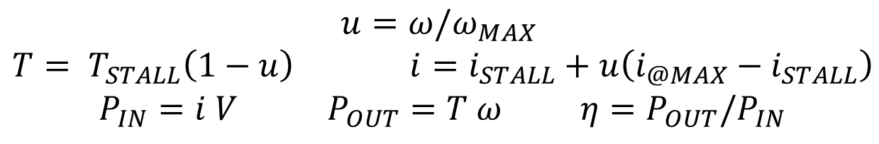
Typical PMDC motor performance curves
(available from the manufacturer, or by test)
Constant V
Efficiency
T_{STALL}
Torque
Power In
Power Out
i_{STALL}
Current
i_{@max}
0
ω_{MAX}
$$u=ω/ω_{MAX}$$
$T= T_{STALL}\left(1−u\right)$ $i=i_{STALL}+u\left(i_{@MAX}−i_{STALL}\right)$
$P_{IN}=i V$ $P_{OUT}=T ω{ η=P}_{OUT}{/P}_{IN}$

Slide 11
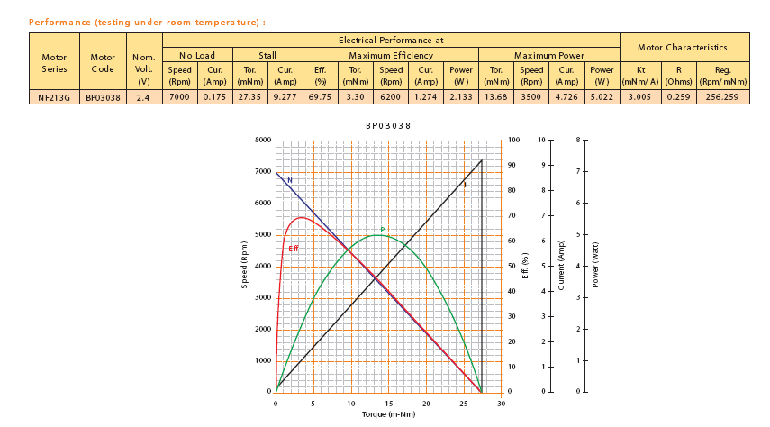
Manufacturer’s data sheet

Slide 12
What is your design objective - maximum power or maximum efficiency?
η
Torque
W
Operates with
max power at this speed
Max Efficiency
@ this speed
½ No Load Speed
No Load Speed

Slide 13
To size the motor, we need to know what it is driving, i.e. the “load” curve
8 gpm
Torque
4 gpm
Typical load curve
for a pump and
plumbing system,
a fan load curve is similar
2 gpm
1 gpm
0.5 gpm
Rotational Speed

Slide 14
The intersection of the load curve and the motor curve will determine the operating speed of the motor
Motor A with
2:1 reduction
Load
Torque
Motor A
Larger Motor
Rotational Speed

Slide 15
Other concerns
Motor Life:
  Internal losses (resulting in heat) ~ I² This determines the maximum steady state current
  High temperature can demagnetize magnets, melt insulation
Typical gear efficiency: 70-80% for each stage

Slide 16
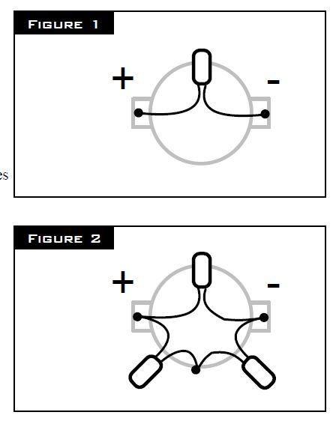
Noise suppression capacitors

Slide 17
Brushless motors
Stationary coils that are electrically
commutated
Rotating permanent magnets
In-runner – magnetic core inside coils
Out-runner – magnetic cup outside coils
Sense rotor angle using Hall effect sensors or EMF in non-powered coils
Typically three coils wired as Wye or Delta
Bidirectional coil drivers

Slide 18
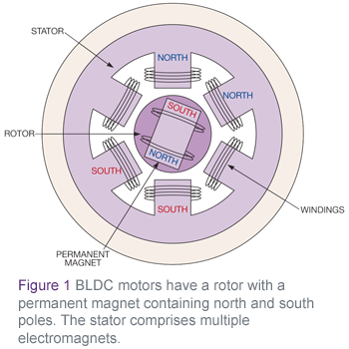
Brushless motors – stator coils, rotor PM

Slide 19
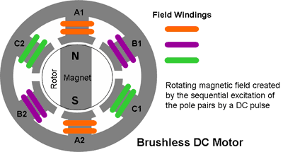
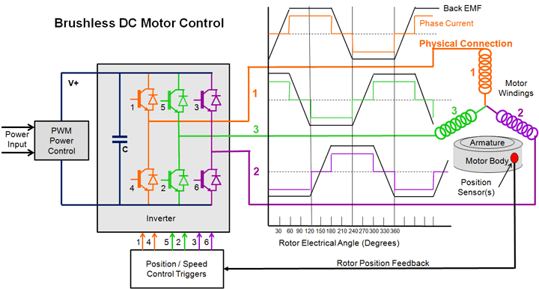
Brushless motors - commutation

Slide 20
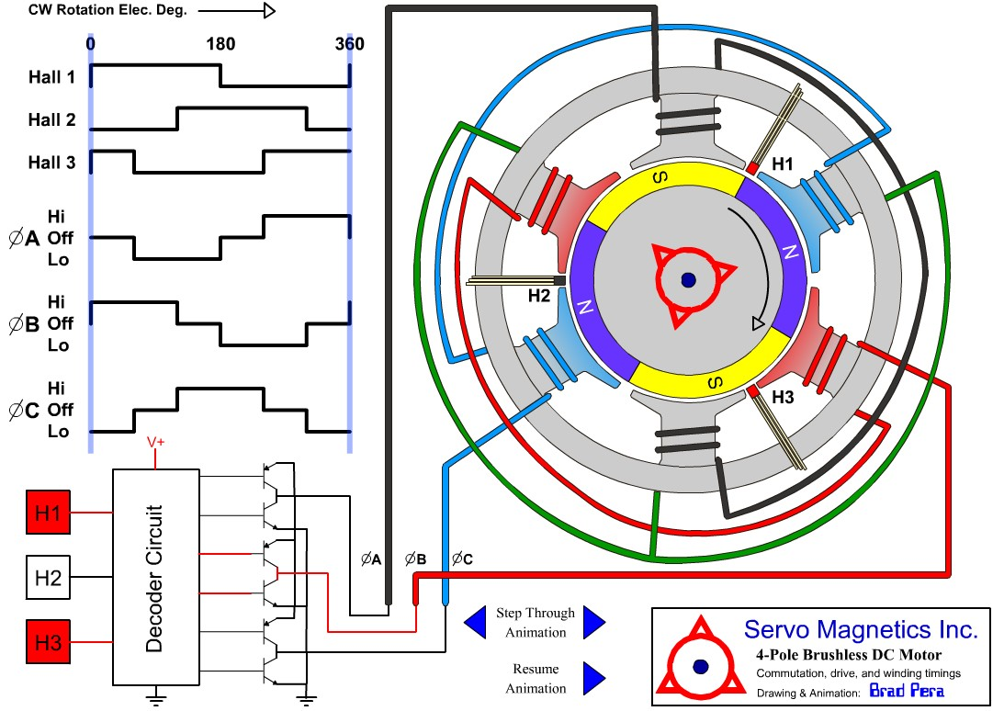
Brushless motors - commutation

Slide 21
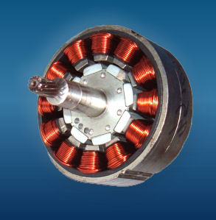
Brushless motor – in-runner

Slide 22
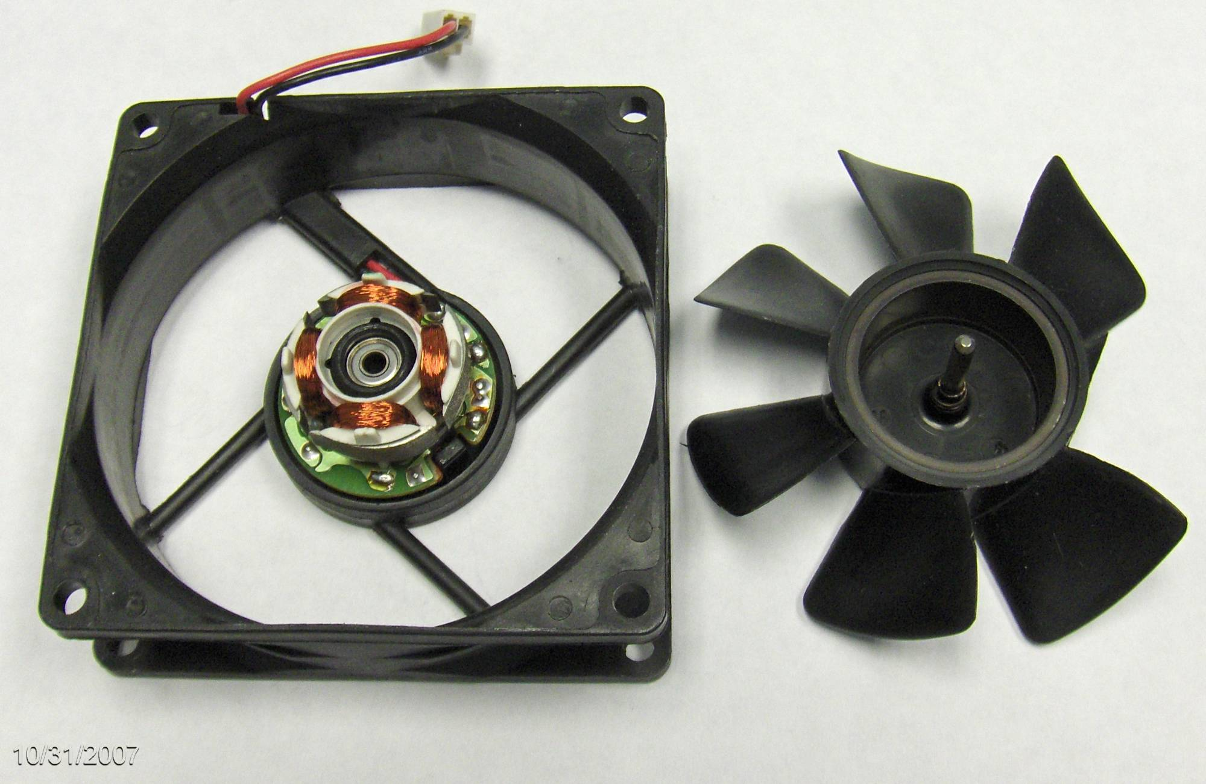
Brushless motor – out-runner
Magnet
Stationary
Coils
Circuitry to
switch coil
polarity
Magnetic
sensor
22

Slide 23
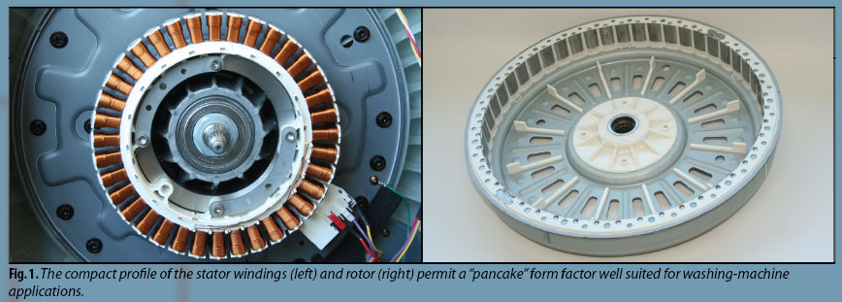
Brushless motors – out-runner

Slide 24
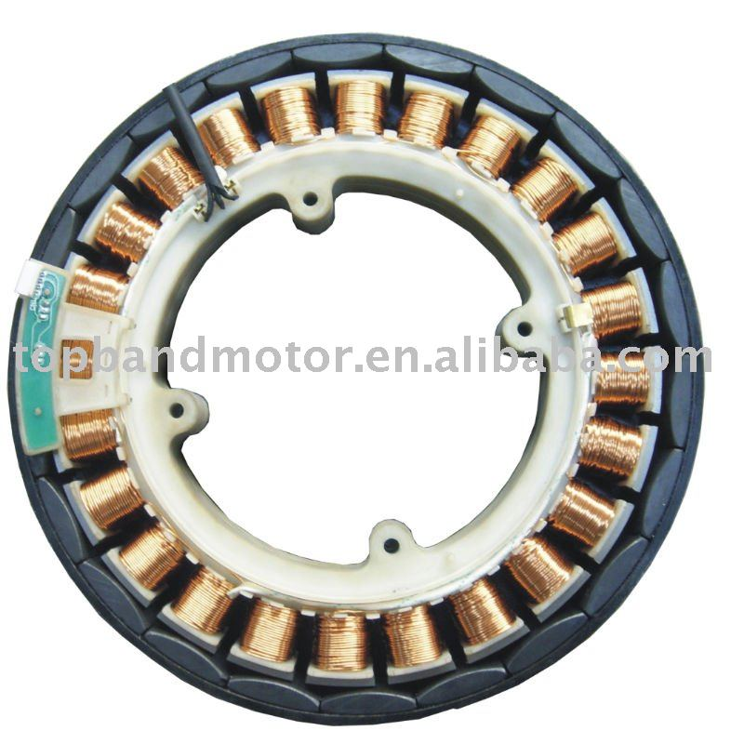
Brushless motors – out-runner

Slide 25
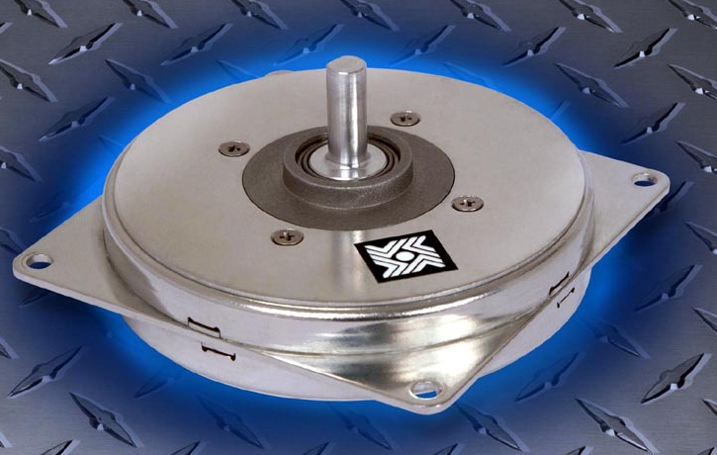
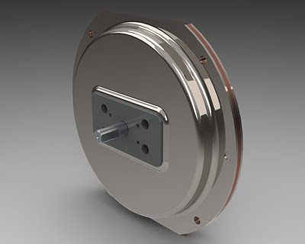
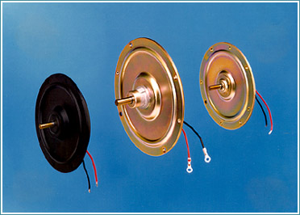
Brushless motors – pancake

Slide 26
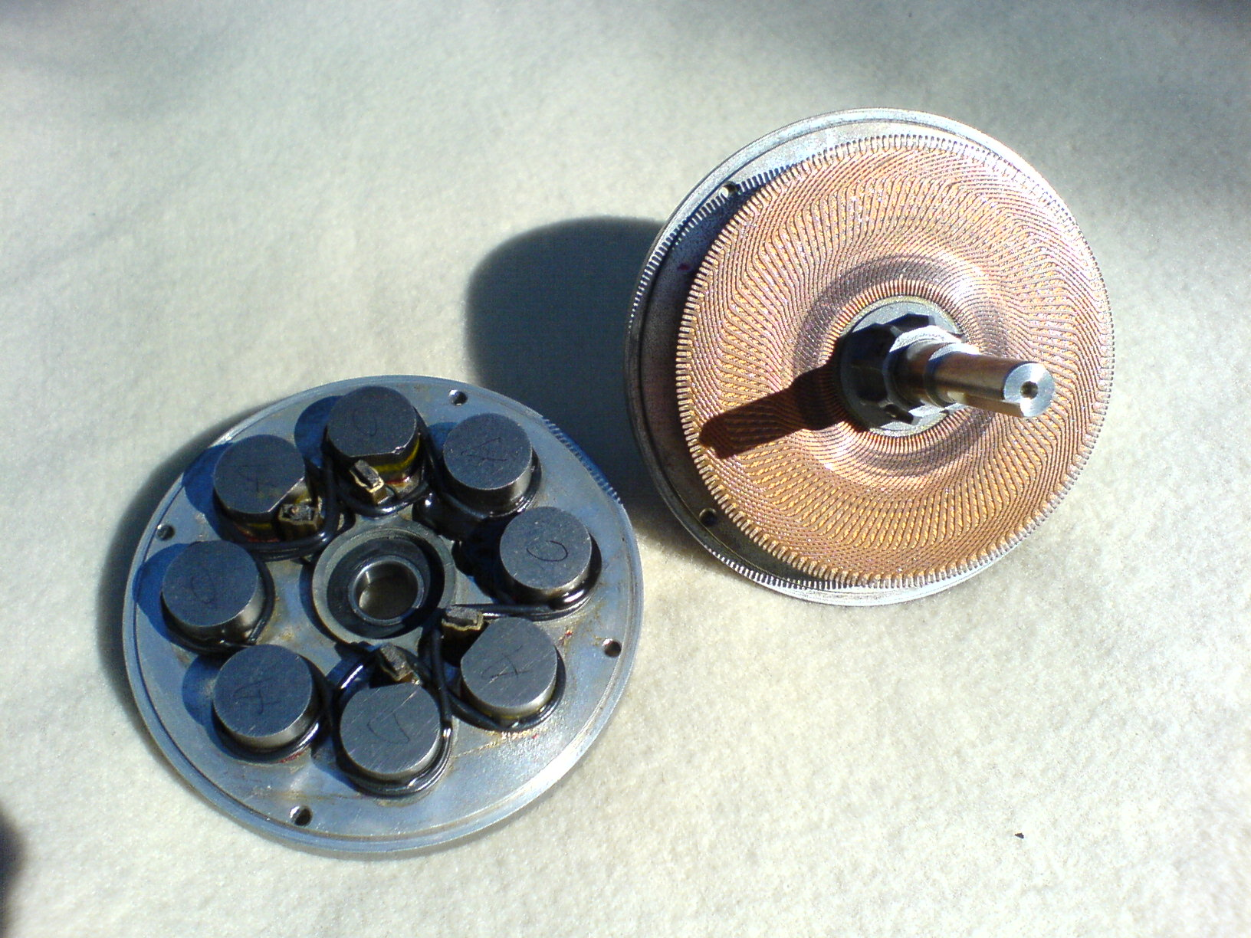
Brushless motors – printed rotor

Slide 27
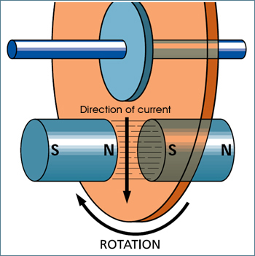
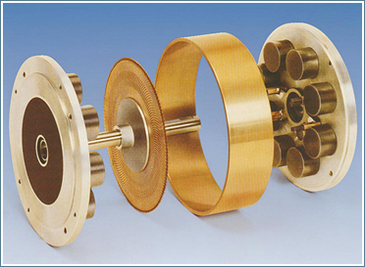
Brushless motors – printed rotor

Slide 28
Batteries – types
Alkaline (C, AA, AAA, 9V)
  1.5V per cell, cheap, generally not rechargeable
Lead acid (automotive)
  12V, sulphuric acid, never below 10.5V
Sealed lead acid (SLA) - gel cell, absorbed glass mat (AGM)
  6V or 12V, any orientation, never below 10.5V for 12V
NiCd (nickel-cadmium)
  1.2V per cell, may discharge completely
NiMH (nickel-metal-hydride)
  1.2V per cell, NEVER discharge completely, self-discharge
LiPo (lithium-polymer)
  dangerous charge/discharge, limited cycles ~300
LiFePO₄ (lithium-iron-phosphate)
  safer, more cycles ~1000

Slide 29
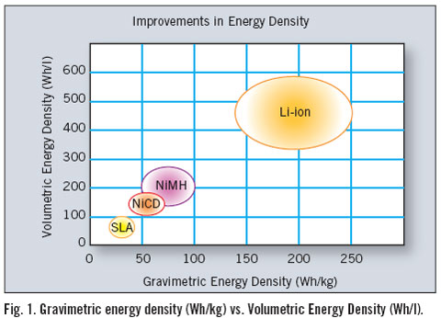
Batteries – energy density

Slide 30
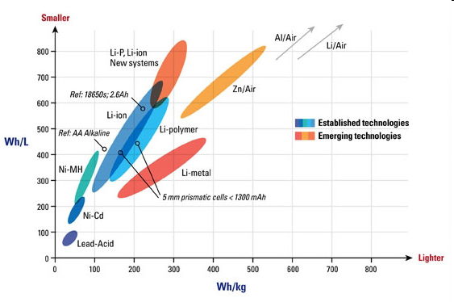
Batteries – energy density

Slide 31
Batteries – rating
Amp-hours (Ah)
  Constant discharge current multiplied by discharge time before reaching minimum recommended voltage
C20 rating is Ah available for 20 hours
  Example: 12V gel-cell battery with 18 Ah rating can provide 0.9 A current continuously for 20 hours before reaching 10.5V minimum threshold

Slide 32
Batteries – discharge curves
Lead acid
  More linear voltage versus time discharge curve
  Higher discharge rate reduces capacity (Peukert’s Law)
  Example: 12V gel-cell battery with 7 Ah C20 rating
    0.35 A discharge, 20 hours = 7 Ah
    0.65 A discharge, 10 hours = 6.5 Ah
    1.2 A discharge, 5 hours = 6.0 Ah
    4.2 A discharge, 1 hours = 4.2 Ah
NiCd
  Flatter voltage versus time discharge curve
  More difficult to monitor remaining capacity
  Discharge rate does not reduce capacity as much as lead acid

Slide 33
12V 18Ah sealed lead acid (SLA)

Slide 34
12V 18Ah sealed lead acid (SLA)

Slide 35
Harbor Freight 18V NiCd battery pack

Slide 36
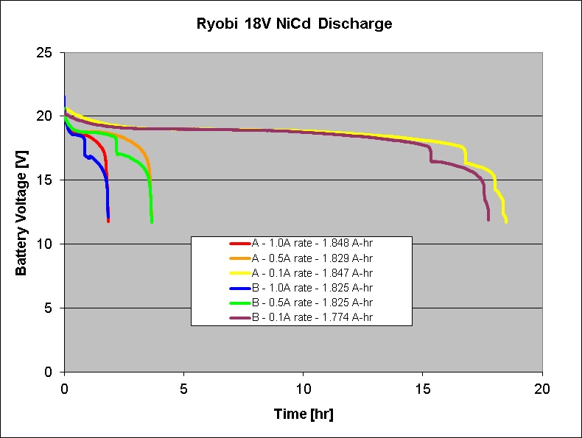
Ryobi 18V NiCd Battery Pack

Slide 37
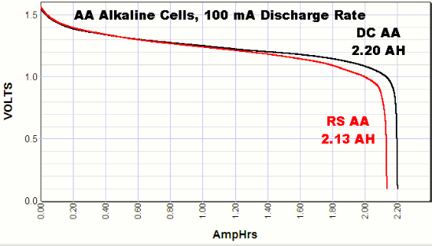
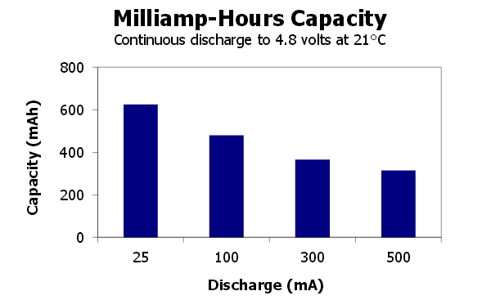
Alkaline discharge curves

Slide 38
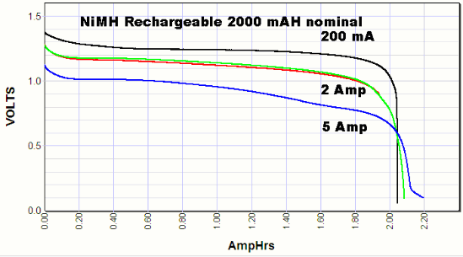
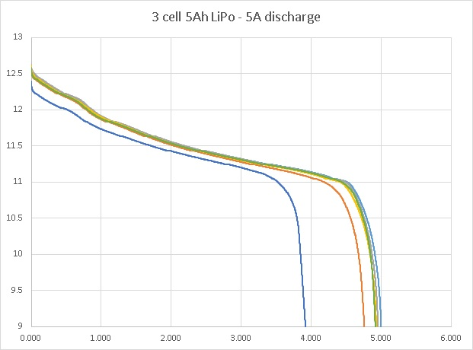
NiMh and LiPo discharge curves

